Slide 1

7 Training Strategies to Increase Microsoft Dynamics CRM User Adoption

Slide 2

Mitch Milam
Dynamics CRM Architect
Independent consultant
Ten–Time Dynamics CRM MVP
Contact me:
mitch@xrmcoaches.com
Infinite–x.net
@mitchmilam

Slide 3
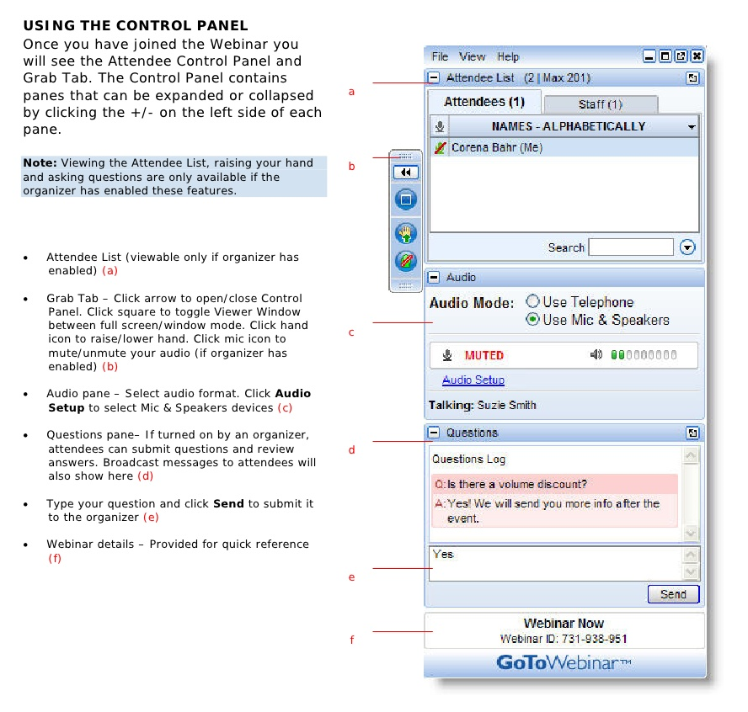
Webinar Housekeeping

Slide 4



2016 Training Roadmap
Webinars
http://www.xrmcoaches.com/webinars
KnowledgeBits
http://www.xrmcoaches.com/knowledgebits
Learning Plans
http://www.xrmcoaches.com/freestuff
More Goodies
Practice tests
On–Demand video training
Instructor–led training
Books

Slide 5
Future Events
Webinar: xRM@Work Live: JavaScript upgrade
Friday, Apr 29, 2016 11:15 AM – 12:15 PM CDT
http://www.infinite-x.net
May events will probably be on the 13th, 20th, and 27th.

Slide 6
Strategy #1: Assemble Your Toolbox

Slide 7
Technical Resources
Microsoft Resources
Microsoft Word
Windows Step Recorder
TechSmith Resources
SnagIt
Camtasia
Jing
ScreenCast.com
Training and Adoption Kit for Microsoft Dynamics CRM

Slide 8
Key Personnel
Subject Matter Experts (SMEs)
Mavens of Knowledge
Masters of the How–To
The WhosIt who knows the WhatsIt

Slide 9
Strategy #2: Define Your Training Delivery Strategy

Slide 10
Internal Web Site

Slide 11
Printed or Online Documentation

Slide 12
Videos

Slide 13
In–Person Training

Slide 14
Webinars

Slide 15
Custom Help

Slide 16
Everyone learns differently so provide a variety of options, if possible

Slide 17
Strategy #3: Solve Small Problems

Slide 18
Create small,
digestible nuggets of content.

Slide 19
Define the problem,
Show them how to solve the problem,
End of lesson.

Slide 20
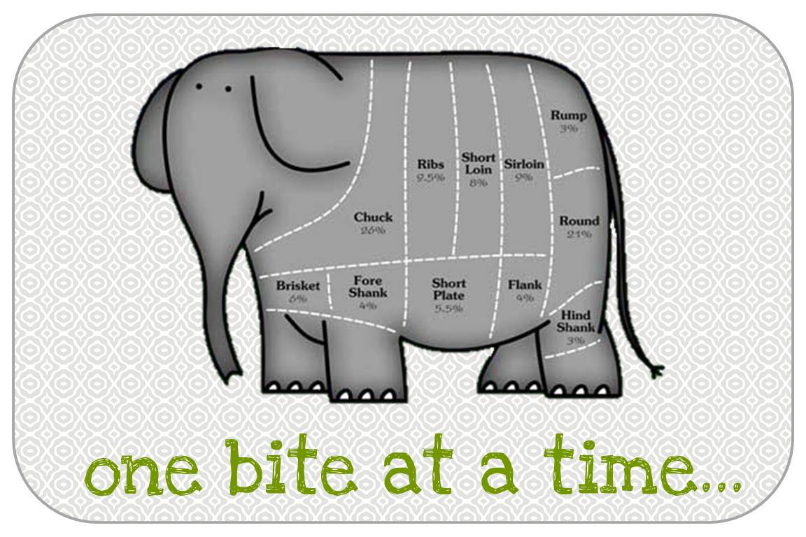
Don’t Forget…

Slide 21
Strategy #4: Ask for Help

Slide 22
Don’t feel you have to create all of the material yourself

Slide 23
Have users or SMEs create content for you
(Windows Step Recorder is great for this)

Slide 24
You are in the editor–in–charge of the final product

Slide 25
Strategy #5: Develop Coaches

Slide 26
Develop Mentors

Slide 27
Identify or develop Subject Matter Experts (SMEs)

Slide 28
Each One, Each One

Slide 29
Strategy #6: Shared Experiences

Slide 30
Lunch and Learns

Slide 31
Topic of the Day webinars

Slide 32
Can be conducted by the training department or by users themselves

Slide 33
Create an internal user’s group (with specific special interests groups (SIGs)

Slide 34
Strategy #7: Final Tips and Tricks

Slide 35
Learning is hard past 4:00pm

Slide 36
MBWA
(Management By Wandering Around)

Slide 37
Create a location to share user’s tips and tricks

Slide 38
Think about using “Gamification” as a way to increase user adoption and learning

Slide 39
Training Strategies Wrap–Up
Assemble your toolbox
Define your training delivery strategy
Solve small problems
Ask for help
Develop coaches
Shared experiences
Assemble your Tips and Tricks

Slide 40
Demonstrations

Slide 41
Questions?

Slide 42
Thank You

